Slide 1
Spark Streaming Windows

Slide 2
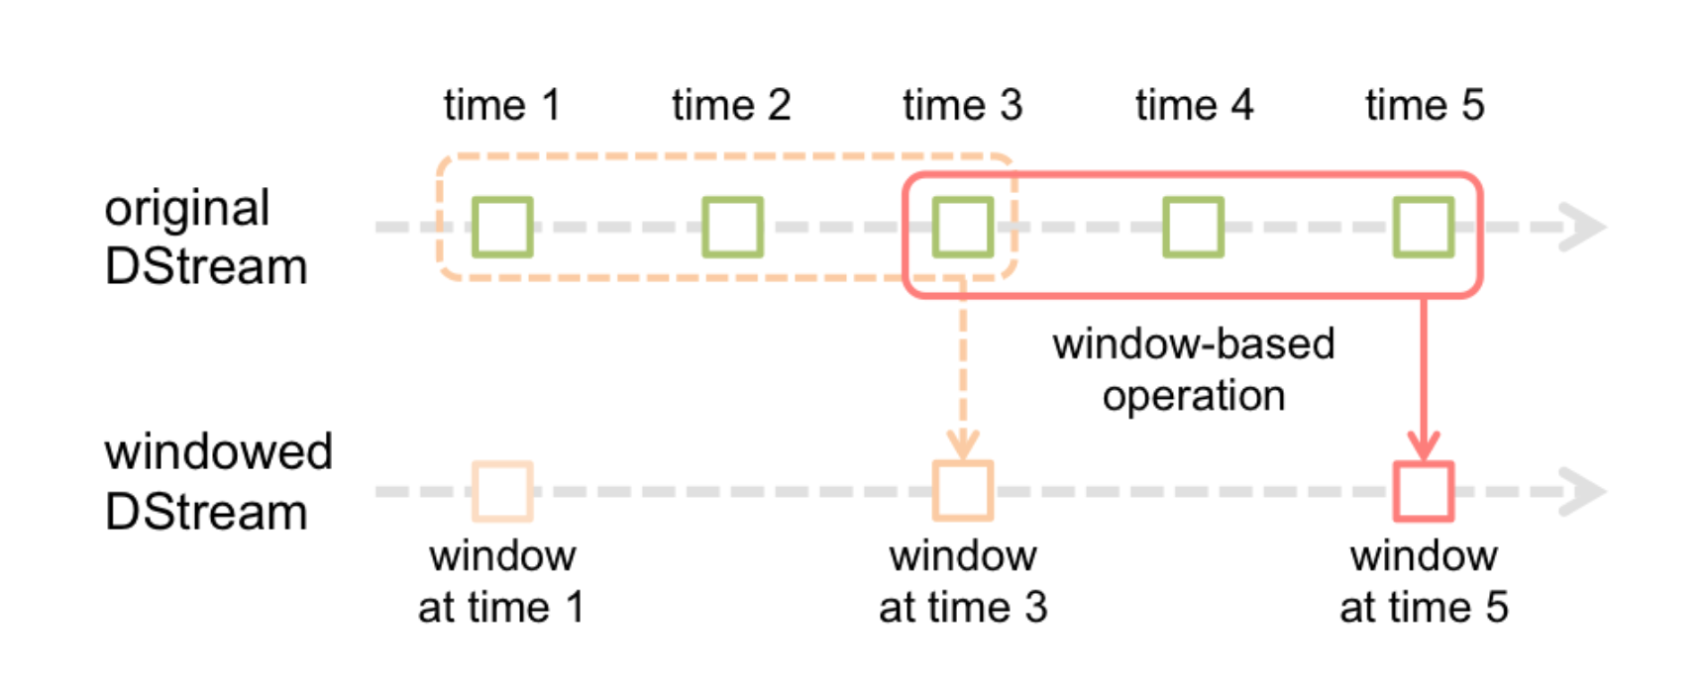
Windows

Slide 3
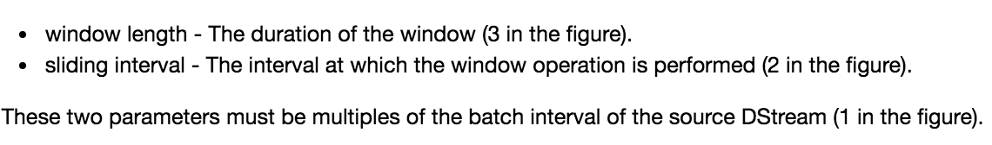

Slide 4
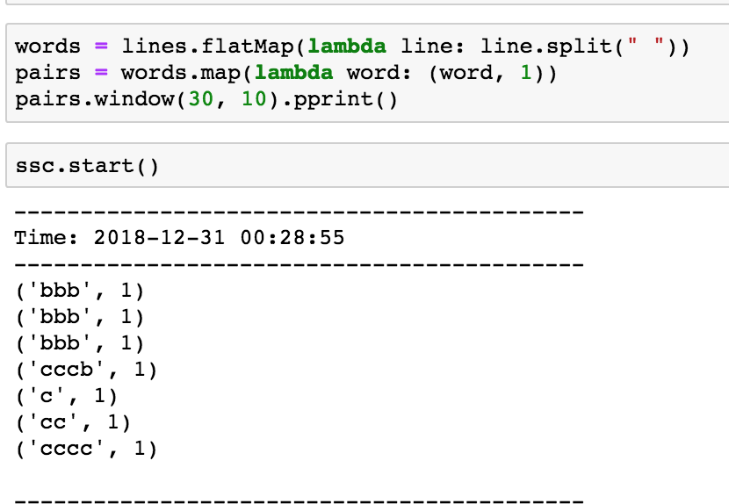
Transformation with Window

